Slide 1


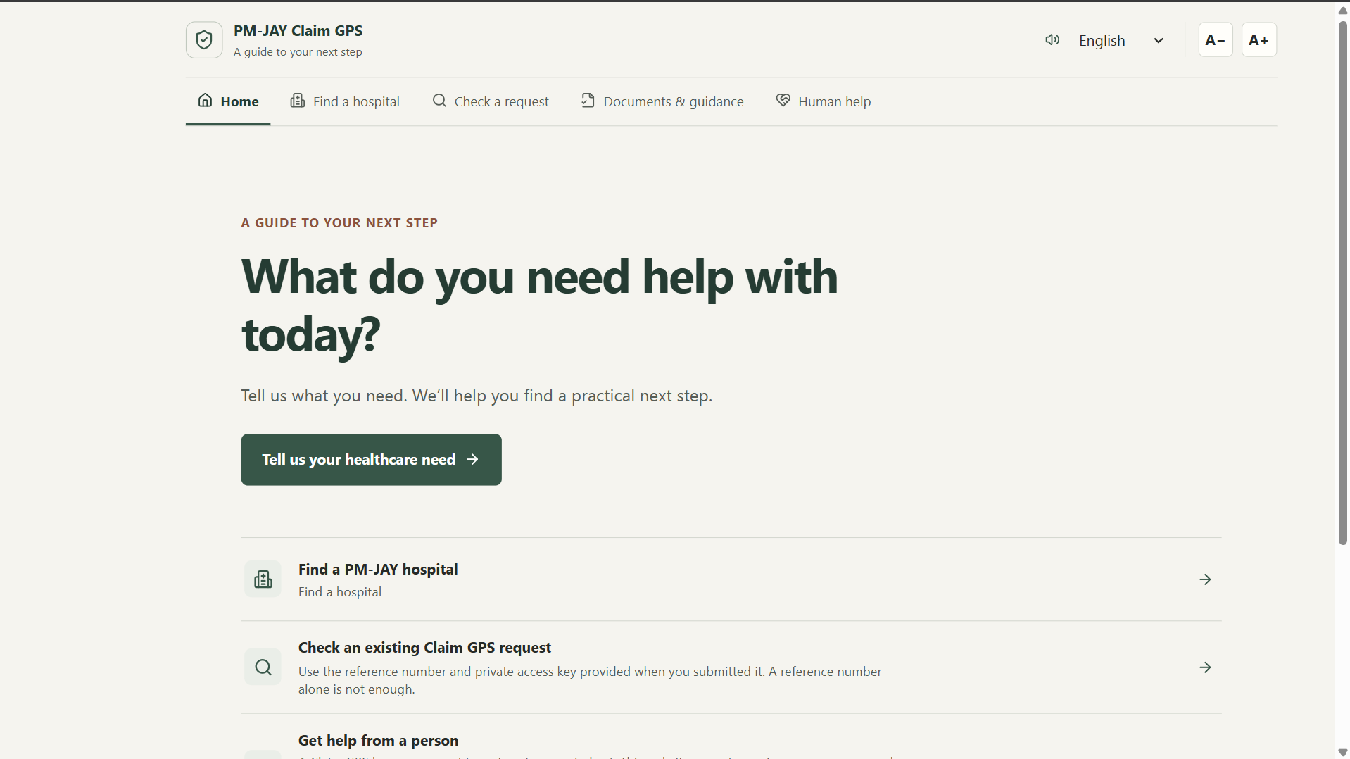
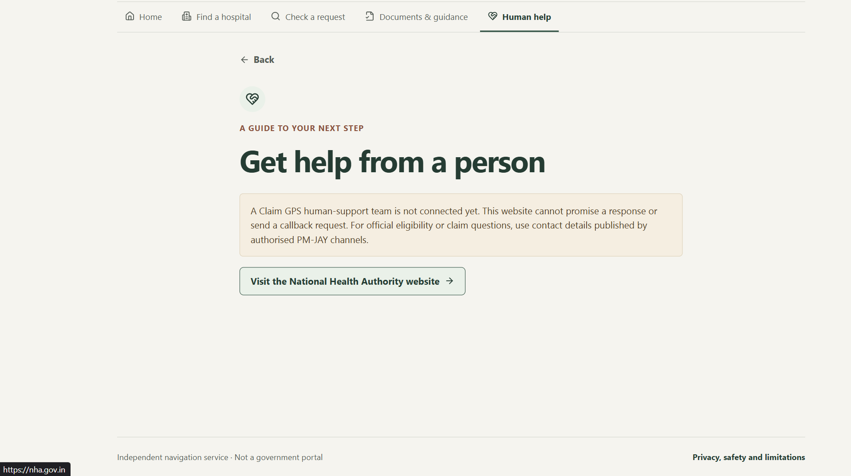
Department of Computer Engineering
NIRMAN LAB EXHIBITION 2026
PM-JAY CLAIM GPS
Arogya Pranali: Intelligent Health Systems for Bharat
3
UN SDG GOAL
GOOD HEALTH & WELL-BEING
AVDHUT PARISH MADHAVI
SEM III • DIV C2 • TU3S2627005
01
Problem Statement
06
Prototype / Circuit/ Photos
People may not know what PM-JAY covers, whether they are eligible, which hospitals to approach, or what to do next. Language, literacy and weak internet can make access harder.
02
Objectives
Make PM-JAY guidance clearer; help users find relevant hospitals; explain documents and next steps.
03
Design Thinking Journey
07
Results, Observations & Failure Log
EMPATHISE — Questionnaire with 23 respondents
DEFINE — Awareness and navigation gaps
IDEATE — Compared awareness, print and digital solutions
PROTOTYPE — Need-first website workflow
Survey of 23 respondents: 65% did not know eligibility; 70% did not know benefits.
74% wished to apply; 65% did not know nearby PM-JAY hospitals.
Finding: strong interest, but practical awareness gaps.
SURVEY INDICATORS | n = 23
Eligibility gap
65%
Benefits gap
70%
Interested
74%
04
Research Evidence
08
Impact
Primary research: questionnaire (n=23).
Key gap: interest in applying is higher than awareness of eligibility, benefits and nearby hospitals.
Reference basis: National Health Authority PM-JAY information and NITI Aayog programme context.
Evidence informs the design; effectiveness still needs validation.
SDG 3: supports navigation to healthcare information.
User value: clearer next steps, easier discovery and less confusion.
Potential to save time and unnecessary trips; actual impact needs testing.
Scale-up: verified hospital data, regional languages and low-connectivity support.
05
Ideation & Solution
09
Conclusion & Future Scope
Need-first workflow: user need → guidance → hospital information → documents → assistance.
PM-JAY Claim GPS turns a healthcare question into a guided next step. Next: test with users, verify hospital records, improve language/accessibility features, and explore authorised integrations.
Guide: Rohini Patil

